Slide 1
Chapter 5 Security evaluation

Slide 2
Evaluating the degree of security
As we saw there are several methodologies to build secure systems
They have been evaluated with respect to their completeness, ease of use, availability of tools, conceptual basis, and other criteria
However, an important question, not considered in most of them is how secure are their final products
A related question is how to evaluate a specific system (built using any or no methodology)
We look at several proposed metrics and propose our own

Slide 3
Attack surface [Man11]
This measure counts the ways through which an adversary can penetrate the system
It does not consider the semantics of the application, only its structural properties
Some of the elements of the attack surface are more risky than others
Some elements may not be obvious, e.g. sensor inputs
This measure does not really measure the security level of a system (defenses in place) but how easy is to attack it.
It can be reduced by applying the need-to-know principle in the authorization service

Slide 4
Common Criteria (CC) [CC]
Evaluates specific products according to protection profiles that define their expected requirements
The Common Criteria provides assurance that the process of specification, implementation and evaluation of a product has been conducted in a rigorous, standard, and repeatable manner at a level that is commensurate with the target environment for use

Slide 5
CC evaluation
Analysis and checking of processes and procedures
Checking that process and procedures are being applied
Analysis of the correspondence between the Target Of Evaluation (TOE) design representations
Analysis of the TOE design representation against the requirements

Slide 6
CC Evaluation II
Certification of proofs
Analysis of guidance documents
Analysis of functional tests developed and results
Independent functional testing
Analysis of vulnerabilities
Penetration testing

Slide 7
CC limitations
It does not try to measure the degree of security of the evaluated product (TOE) or the security of all the products of some methodology.
Any changes in the TOE invalidates the evaluation
On the contrary, evaluation of the design of a product is reusable for a whole product line

Slide 8
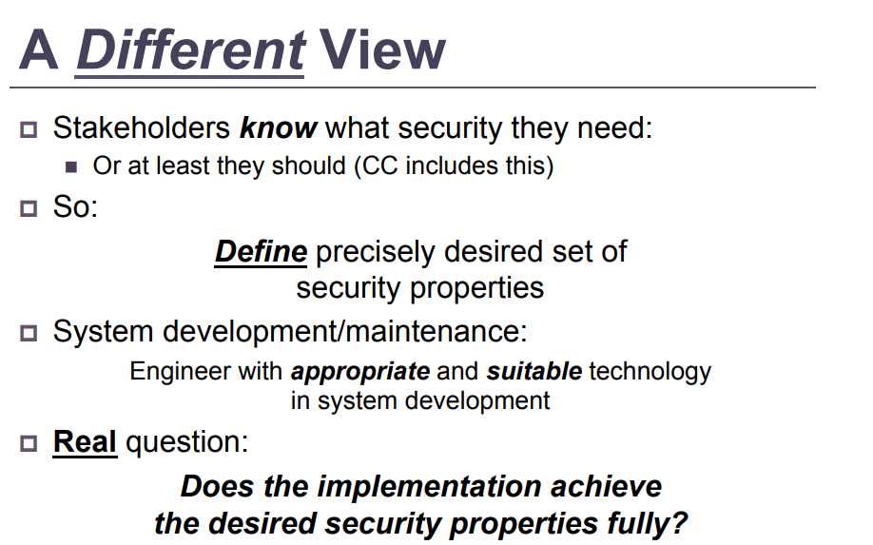

Slide 9
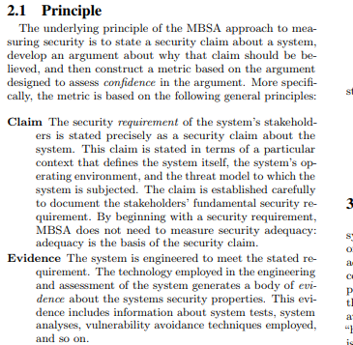
MBSA [Rod14]

Slide 10
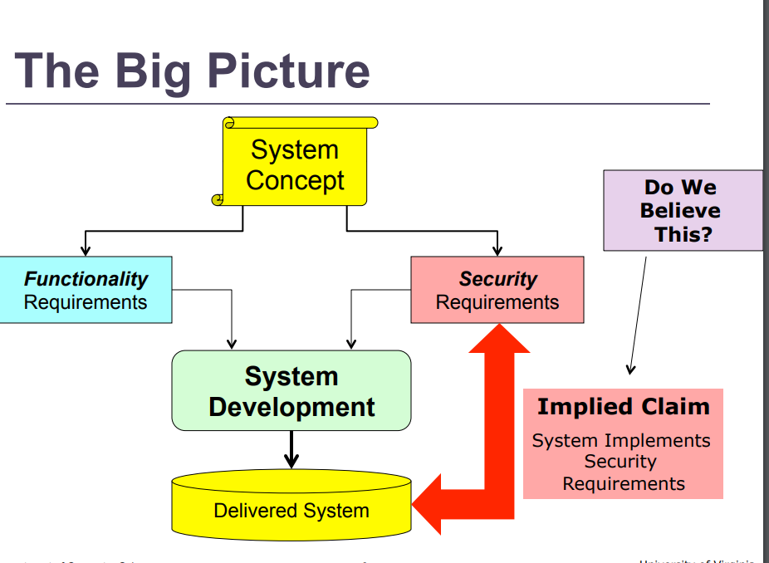

Slide 11
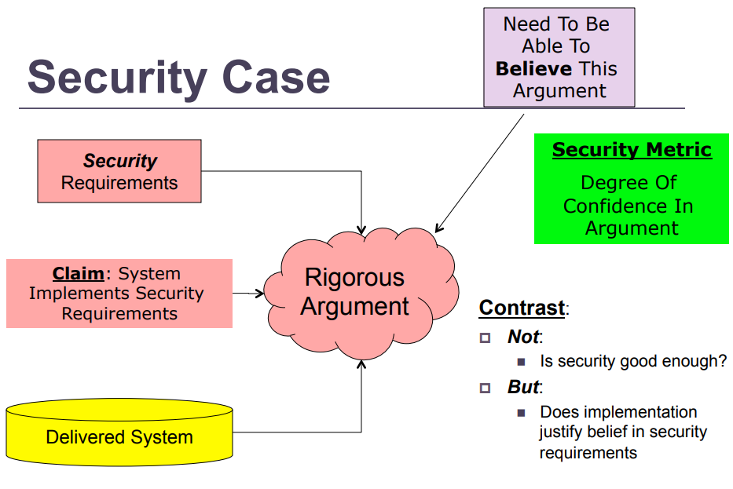

Slide 12
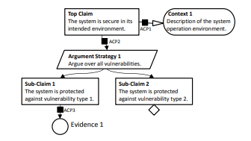
GSM (Goal Structuring Notation)

Slide 13
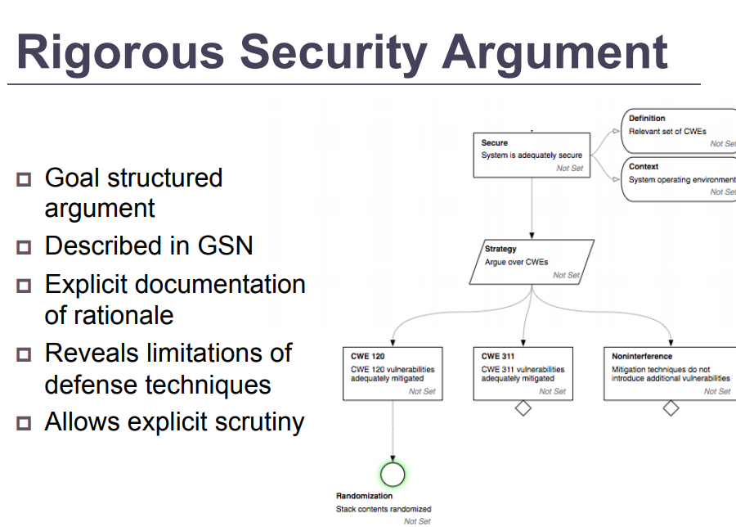

Slide 14
Common Weakness Enumeration (CWE) https://cwe.mitre.org/
CWE™ is a community-developed list of common software security weaknesses. It serves as a common language, a measuring stick for software security tools, and as a baseline for weakness identification, mitigation, and prevention efforts.
List by research concepts, development concepts, and architectural concepts

Slide 15
Arguments
In principle, the engineering of the system should ensure that the system meets the stated security claim.
Doubts arise, however, in terms of the adequacy and completeness of the engineering and assessment, and so belief in the claim might not be warranted.
Thus, in practice the critical issue facing the stakeholders is whether they can believe that the security requirement is met.
Construction of a rigorous argument documents the rationale for belief in the claim based on the available evidence.
In practice, residual doubts in an argument are inevitable. For example, the argument might not have taken into account all possible circumstances

Slide 16
Sources of doubt
Any goal within an argument might or might not be true, and belief in a goal is usually a matter of judgment.
A goal thought to be true might not be true because:
• The inference upon which the goal depends is invalid.
• The evidence upon which the goal depends is invalid or
inaccurate.
• The goal might be invalid for the defined context or the context
definition might be inaccurate for the system of interest

Slide 17
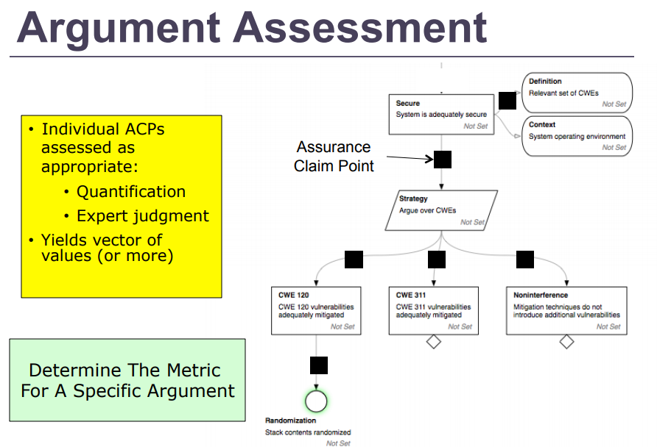

Slide 18
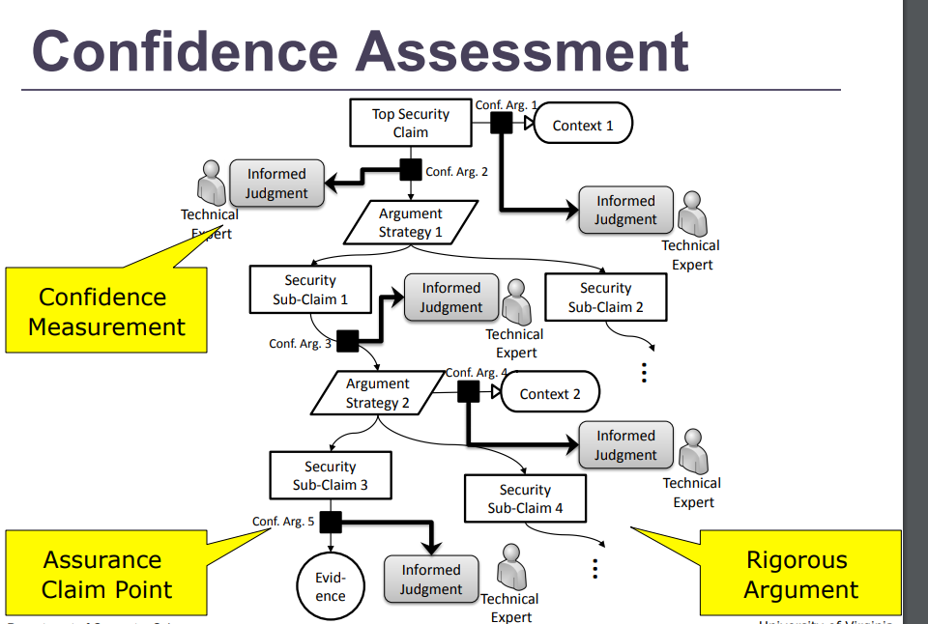

Slide 19
Ericsson’s SECAM
Establishes security requirements not just for products but also for their development process
In CC each product is evaluated and certified
by a third party and accreditation
requirements relate to the evaluation process

Slide 20
Roles
The Accreditor verifies the development process, not the product
The Evaluator verifies that the product actually meets its security requirements
The manufacturer can be an evaluator after they have been verified by an Accreditor, who checks that the manufacturer can fulfill the security assurance requirements and is able to evaluate products

Slide 21
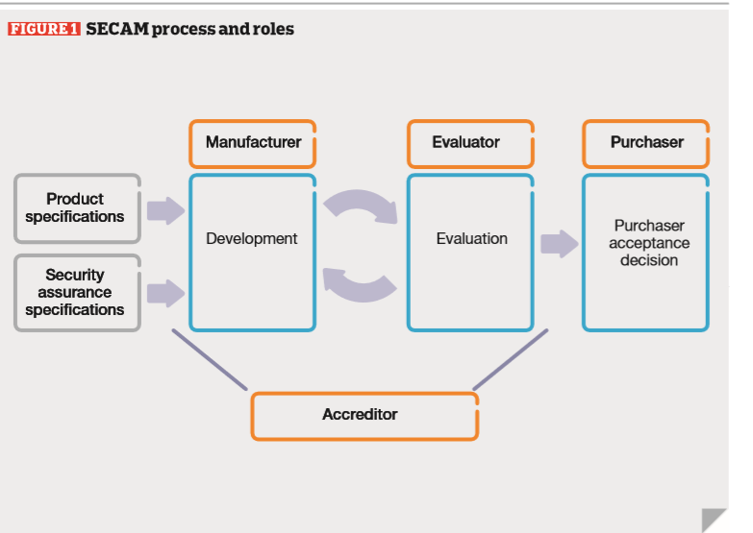

Slide 22
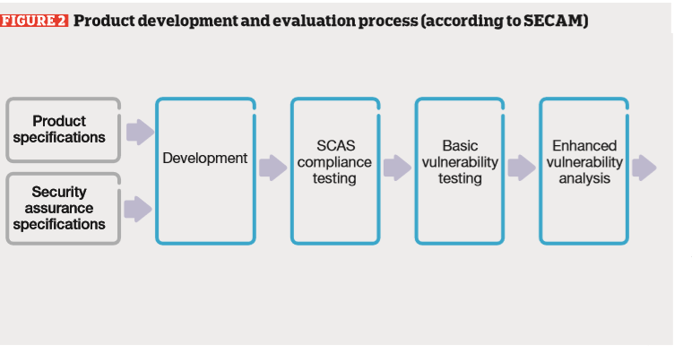

Slide 23
Security assurance requirements in 3GPP
The manufacturer shall:
use appropriate development-site protection; deploy sufficient version and configuration management;
apply secure coding guidelines;
and ensure that a suitable patch management process is in place.
Assurance id the level of confidence that system is free from vulnerabilities (intentional or accidental)

Slide 24
Security assurance requirements
Some examples of requirements relating to the development process include that the manufacturer shall:
use appropriate development-site protection; deploy sufficient version and configuration management;
apply secure coding guidelines; //we use models
and ensure that a suitable patch management process is in place.

Slide 25
Vulnerabilities
There are several approaches to measure vulnerabilities in a specific system, e.g., OWASP, CVE, CVSS, CWE, and others.
However, they only can measure a specific system implementation, they are not a measure of the quality of the design.

Slide 26
A measure of security
As a way to get a handle on the problem of security evaluation, it has been suggested designing systems that exhibit measurable properties
We are following this idea by taking advantage of patterns and reference architectures
We first enumerate threats and verify if they all have been stopped or mitigated by some security mechanism realizing a security pattern
The percentage of threat coverage by patterns is our security measure
We indicate how this approach could be refined by using the Twin peaks approach
We enumerate threats by considering all the actions in each use case, but other approaches for this enumeration would also be acceptable.

Slide 27
Enumerating threats
We can enumerate threats by considering all the actions in each use case and analyze how they could be subverted by an attacker to reach his goals (Seen in Chapter 1).
We have described how to evaluate secure methodologies in general but in that evaluation we concentrated on aspects such as correctness, completeness, and usability and did not consider explicitly the way to evaluate the degree of security.

Slide 28
A security metric
A threat Ti uses a sequence of attack steps Tik; that is: Ti → Ti1, Ti2, …, Tij.
In order to stop Ti we only need to stop one of the Tij, which can be done by applying security patterns that stop that specific attack step.
Formally, if T = set of threats for a system, Py = set of policies that stop or mitigate T, and Pt = set of patterns that realize Py, we have then: T → Py → Pt, for all t in T → there exists Py → Pt that is, if for all the threats in the system, we can find a set of policies that can be realized as a set of patterns that neutralize those threats, we consider the system to be secure.
A specific design may include patterns to stop a set of threats.
If TN is the number of stopped/mitigated threats and T is the total number of identified threats, we can define a Security Coverage, SC, as TN/T, which measures the quality of the defenses

Slide 29
Applying the metric
Enumerate threats based on attacker’s goals. As shown earlier
Rank threats according to their impact and probability of occurrence. This may be hard to estimate in some cases.
Determine SC as above.
If this value is considered too low, analyze which threats have not been handled by the architecture and try to reinforce the system
This process can be repeated until the degree of security is considered acceptable
The process can be applied during design, instead of the final product

Slide 30
Criteria for a good security metric applied to our measure
Correctness—threats are a basic quality criteria for security metrics and mitigating them will improve the security of the system.
Measurability—we can enumerate a reasonably complete list of threats and count the corresponding security patterns that can cover them.
Meaningfulness—applying defenses against the identified threats will make the system more secure. Two sub-aspects of meaningfulness are:
Comparability—It is now possible to compare two systems based on their threat coverage.
Progression. Adding security patterns we can improve security. Each new security pattern may improve security.
Usability—the method for threat enumeration and the use of patterns are rather simple approaches that do not require designers to be security experts.

Slide 31
Metric refinement

Slide 32
Refinement of the metric
As indicated earlier, our threat enumeration method starts from a conceptual model of the functional requirements; we can analyze its use cases to produce activity diagrams, where the activity diagram uncovers threats as attacker goals and identifies assets at the same time.
To define each architecture we can use RAs which in each stage become more concrete. The concrete architectures introduce new architectural artifacts that can also be attacked and therefore must be protected, e.g., a new database can now be attacked.
We refine the goal-based threats to produce a design model which is effectively a SRA. This is refined to produce a new architecture and the cycle repeats. In each cycle we can consider the same use cases but in more detailed versions, considering the new artefacts.

Slide 33
Extension
Even if the product software was not done using object-oriented methods, it is still possible to define use cases (complete user interactions with the product; e.g. define rules for a firewall). Then each activity in a use case can be analyzed to see what are the goals of the attacker and his threats.
Even if no patterns were used in building a product, it is possible to discover them as abstractions of the security mechanisms that are actually implemented in the product.
In this case we can still apply this metric.
Possible project: verify this claim using an example

Slide 34
Validation or certification of security
Ericsson and 3GPP use a lightweight version of the CC (SECAM)
Not clear how it will be done in 5GPP
Samsung uses Common Criteria
Apple uses ISO 27001 and 27018
They assume that requirements are correct but they do not show how the requirements were obtained
We find requirements by enumerating threats

Slide 35
Samsung Knox
A set of security enhancements
Holistic evaluation of products
Requirements described in Device Fundamental Protection Profile based on FIPS (cryptographic standards) and in [Sam18]
Also PP of IPSEC VPN

Slide 36
Samsung Tizen
Tizen is an operating system based on the Linux kernel and the GNU C Library implementing the Linux API.
Tizen works on a wide range of Samsung devices including smartphones, tablets, in-vehicle infotainment (IVI) devices, smart TVs, PCs, smart cameras, wearable computing (such as smartwatches), Blu-ray players, printers and smart home appliances (such as refrigerators, lighting, washing machines, air conditioners, ovens/microwaves and a robotic vacuum cleaner)
Tizen provides application development tools based on the JavaScript libraries jQuery and jQuery Mobile. Since version 2.0, a C++ native application framework is also available, based on an Open Services Platform from the Bada platform.
Samsung is the only Tizen member incorporating and developing the operating system, increasingly distributing it to its products. As of 2016 Samsung is planning on making Tizen its main operating system on all smartphones, replacing Android. As of Q1 2017 Tizen is second largest smartwatch platform, behind watchOS and ahead of Android Wear.
Many zero-day vulnerabilities have been found.

Slide 37
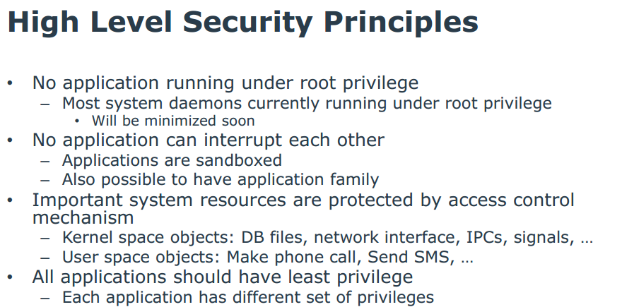
Tizen OS security principles [Gad14]

Slide 38
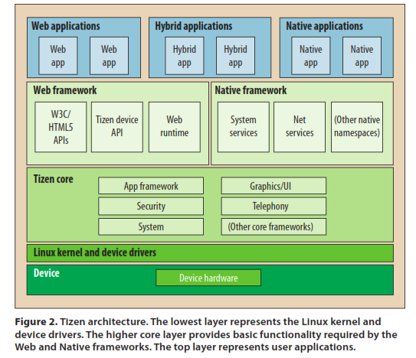
Tizen OS

Slide 39
Patterns in Tizen OS [Gad14]
Layers
Controlled VAS (Sandbox)
Multilevel Access Control (Mandatory Model)
Digital Signature
The vulnerabilities found in Tizen show that good principles and patterns are not enough. The complete architecture must be well structured and organized to stop the propagation of attacks.

Slide 40
References
[CC] Common Criteria Portal, last accessed February 22, 2015. https://www.commoncriteriaportal.org/
E.B.Fernandez, N. Yoshioka, H. Washizaki, “Evaluating the degree of security of a system built using security patterns”, 13th International Conference on Availability, Reliability and Security (ARES 2018), Hamburg, Germany, Sept. 2018
[Man11] K. Manadhata, J.M.Wing, “An attack surface metric”, IEEE Trans. on Soft. Eng., vol. 37, No 3, May/June 2011, 371-386.
[Rod14] B.D.Rodes, J.C.Knight, K.S.Wasson, “A security metric based on security arguments”, WETSoM’14, June 2014, Hyderabad, India, 66-72.
Reijo M. Savola: “Quality of security metrics and measurements”. Computers & Security 37: 78-90 (2013)

Slide 41
More refs.
Apple inc., iOS security: iOS 11.4, August 2018, https://www.apple.com/business/site/docs/iOS_Security_Guide.pdf
[Gad14] Olga Gadyatskaya; Fabio Massacci; Yury Zhauniarovich, “Security in the Firefox OS and Tizen Mobile Platforms”, Computer, IEEE 2014, Volume: 47, Issue: 6 , 57 - 63, DOI: 10.1109/MC.2014.165
Samsung, Samsung Knox security solution (white paper) V2, May 2017, https://www.samsungknox.com/docs/SamsungKnoxSecuritySolution.pdf

